Slide 1
Nanoscale thermal transport
Lecture 4
Riley Hanus
http://rileyhanus.com/science.html

Slide 2
A breakdown of phonon thermal conductivity
The vibrational (lattice) Hamiltonian
The Harmonic Hamiltonian
Types of phonon scattering
Scattering potential → Scattering Probability → Relaxation time (lifetime)
point defects
line defects
planar defects
Phonon-phonon scattering
Low-frequency behavior of thermal conductivty

Slide 3
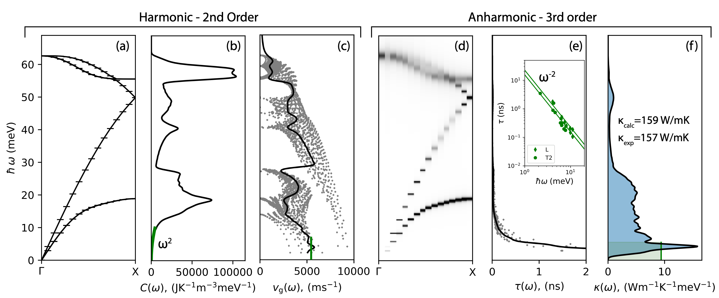
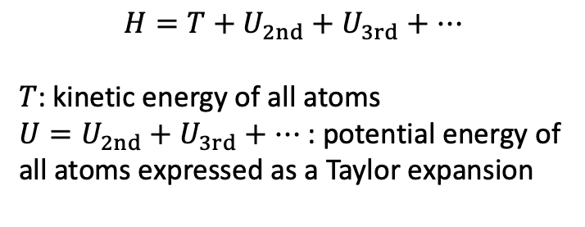
Phonon scattering and thermal conductivity
$$H=T+U_{2nd}+U_{3rd}+…$$
$T$: kinetic energy of all atoms
$U=U_{2nd}+U_{3rd}+…$: potential energy of all atoms expressed as a Taylor expansion

Slide 4
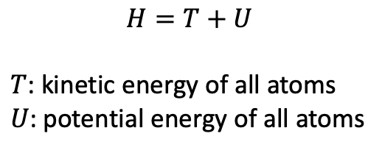
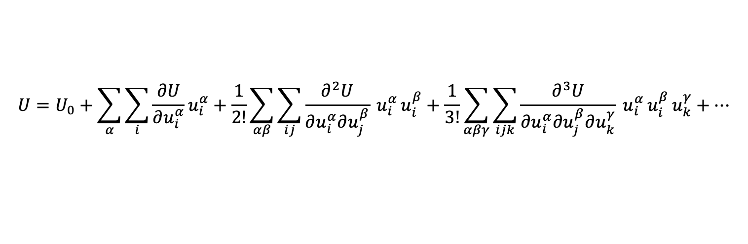
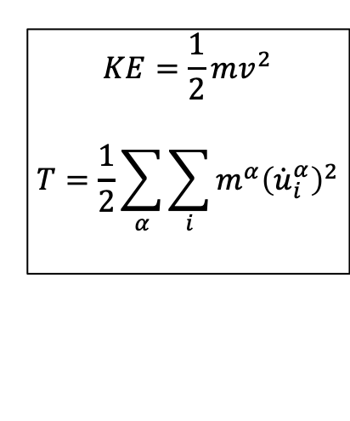
on board
Hamiltonian
Energy of a solid is described by its Hamiltonian, $H$
$$H=T+U$$
$T$: kinetic energy of all atoms
$U$: potential energy of all atoms
$$KE=\frac{1}{2}mv^{2}$$
$$T=\frac{1}{2}\sum_{α}{\sum_{i}{m^{α}{\left({\dot{u}}_{i}^{α}\right)}^{2}}}$$
PE = ???
Taylor expand it:
reference energy, set this to zero
$$U=U_{0}+\sum_{α}{\sum_{i}{\frac{∂U}{∂u_{i}^{α}}u_{i}^{α}}}+\frac{1}{2!}\sum_{αβ}{\sum_{ij}{\frac{∂^{2}U}{∂u_{i}^{α}∂u_{j}^{β}} u_{i}^{α }u_{i}^{β}}}+\frac{1}{3!}\sum_{αβγ}{\sum_{ijk}{\frac{∂^{3}U}{∂u_{i}^{α}∂u_{j}^{β}∂u_{k}^{γ}} u_{i}^{α }u_{i}^{β}}}u_{k}^{γ}+…$$
linear term is zero when all atoms are in their equilibrium positions

Slide 5
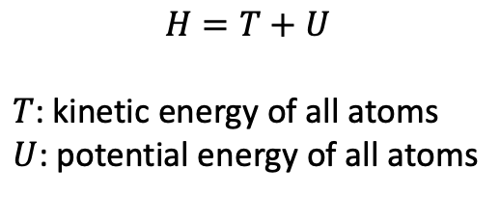
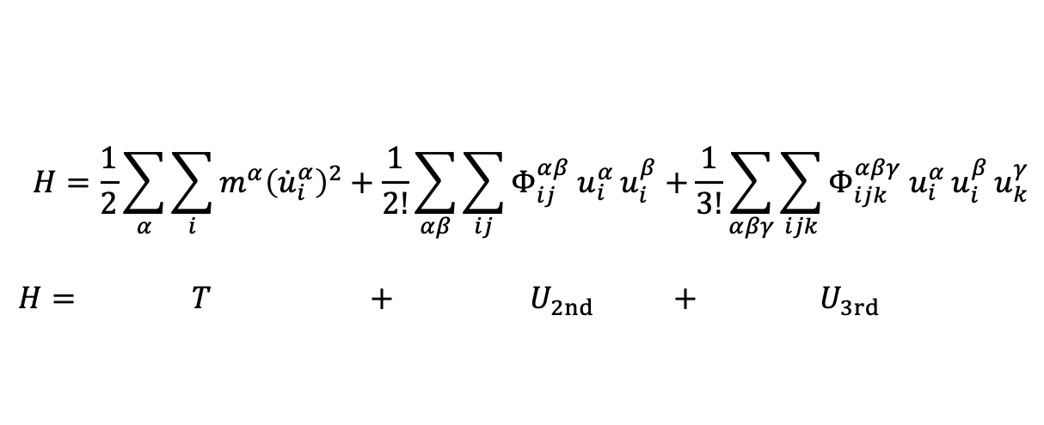
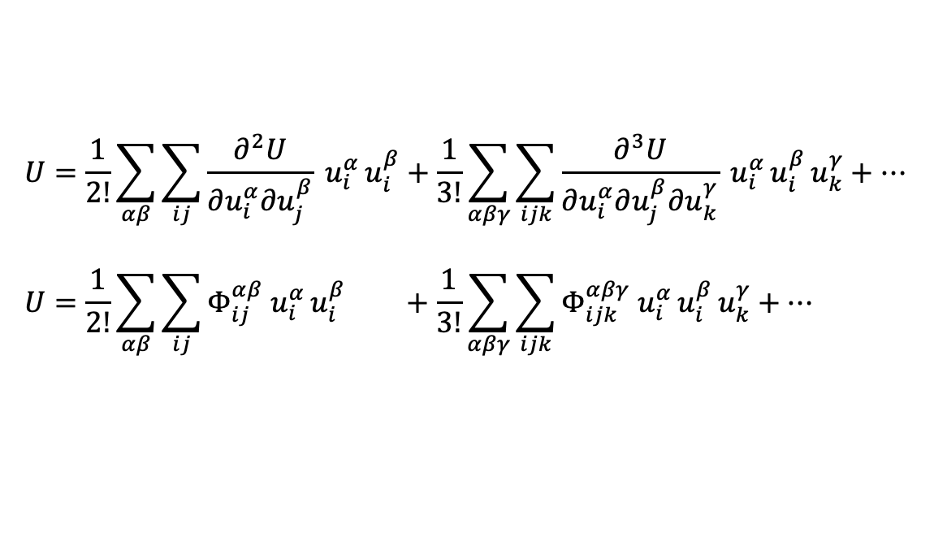
on board
Hamiltonian
Energy of a solid is described by its Hamiltonian, $H$
$$H=T+U$$
$T$: kinetic energy of all atoms
$U$: potential energy of all atoms
$$U=\frac{1}{2!}\sum_{αβ}{\sum_{ij}{\frac{∂^{2}U}{∂u_{i}^{α}∂u_{j}^{β}} u_{i}^{α }u_{i}^{β}}}+\frac{1}{3!}\sum_{αβγ}{\sum_{ijk}{\frac{∂^{3}U}{∂u_{i}^{α}∂u_{j}^{β}∂u_{k}^{γ}} u_{i}^{α }u_{i}^{β}}}u_{k}^{γ}+…$$
$$U=\frac{1}{2!}\sum_{αβ}{\sum_{ij}{Φ_{ij}^{αβ} u_{i}^{α }u_{i}^{β}}} +\frac{1}{3!}\sum_{αβγ}{\sum_{ijk}{Φ_{ijk}^{αβγ} u_{i}^{α }u_{i}^{β}}}u_{k}^{γ}+…$$
$$H=\frac{1}{2}\sum_{α}{\sum_{i}{m^{α}{\left({\dot{u}}_{i}^{α}\right)}^{2}}}+\frac{1}{2!}\sum_{αβ}{\sum_{ij}{Φ_{ij}^{αβ} u_{i}^{α }u_{i}^{β}}}+\frac{1}{3!}\sum_{αβγ}{\sum_{ijk}{Φ_{ijk}^{αβγ} u_{i}^{α }u_{i}^{β}}}u_{k}^{γ}$$
$$H= T + U_{2nd} + U_{3rd}$$

Slide 6
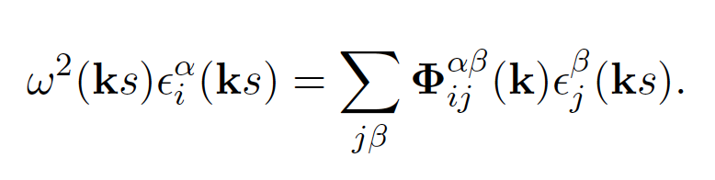
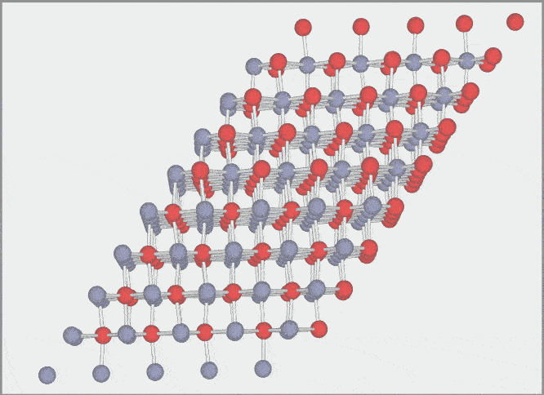
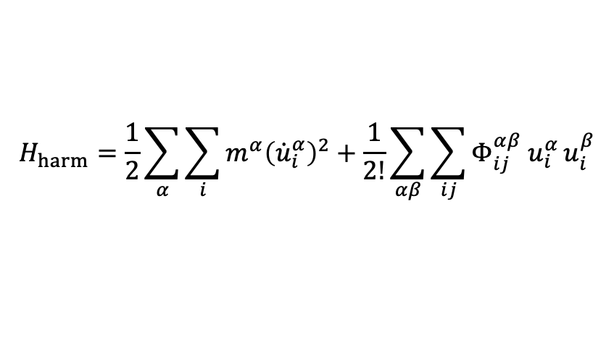
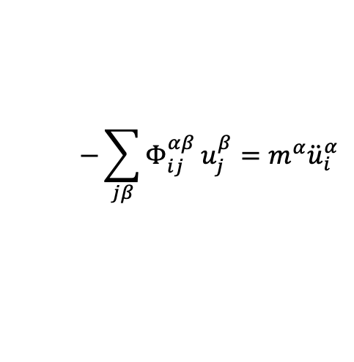
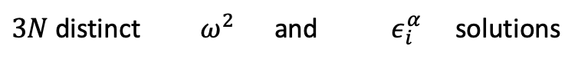
Harmonic Hamiltonian
$$H_{harm}=\frac{1}{2}\sum_{α}{\sum_{i}{m^{α}{\left({\dot{u}}_{i}^{α}\right)}^{2}}}+\frac{1}{2!}\sum_{αβ}{\sum_{ij}{Φ_{ij}^{αβ} u_{i}^{α }u_{i}^{β}}}$$
$$−\sum_{jβ}{Φ_{ij}^{αβ}}u_{j}^{β}=m^{α}{\ddot{u}}_{i}^{α}$$
Allows us to write this equation of motion:
$3N$ distinct $ω^{2}$ and $ε_{i}^{α}$ solutions

Slide 7
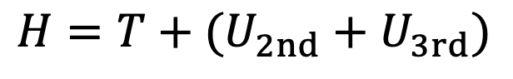
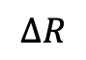
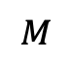
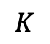
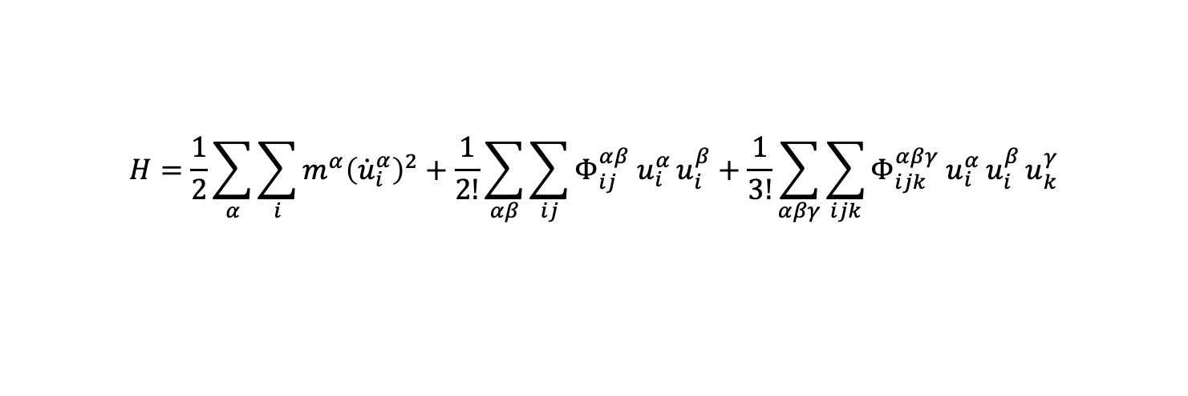
Types of perturbations
$$H=T+(U_{2nd}+U_{3rd})$$
$$M$$
$$K$$
$$ΔR$$
$$H=\frac{1}{2}\sum_{α}{\sum_{i}{m^{α}{\left({\dot{u}}_{i}^{α}\right)}^{2}}}+\frac{1}{2!}\sum_{αβ}{\sum_{ij}{Φ_{ij}^{αβ} u_{i}^{α }u_{i}^{β}}}+\frac{1}{3!}\sum_{αβγ}{\sum_{ijk}{Φ_{ijk}^{αβγ} u_{i}^{α }u_{i}^{β}}}u_{k}^{γ}$$
Mass (density) changes
Spring constant changes
Changes in strain

Slide 8
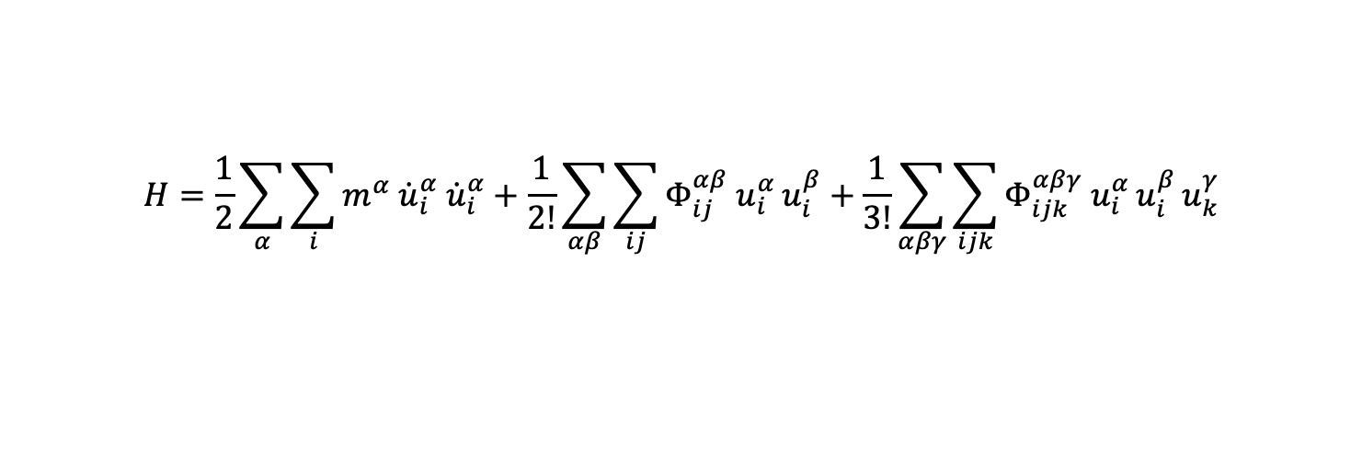
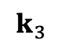
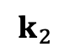
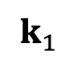
Types of perturbations
Mass contrast scattering
Bond strength contrast scattering
$$H=\frac{1}{2}\sum_{α}{\sum_{i}{m^{α}{ \dot{u}}_{i}^{α}{ \dot{u}}_{i}^{α}}}+\frac{1}{2!}\sum_{αβ}{\sum_{ij}{Φ_{ij}^{αβ} u_{i}^{α }u_{i}^{β}}}+\frac{1}{3!}\sum_{αβγ}{\sum_{ijk}{Φ_{ijk}^{αβγ} u_{i}^{α }u_{i}^{β}}}u_{k}^{γ}$$
$$k_{3}$$
Phonon-phonon scattering
$$k_{1}$$
$$k_{2}$$

Slide 9
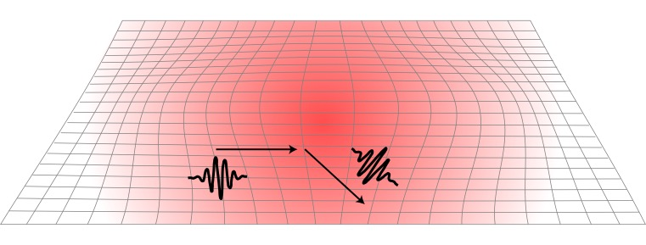
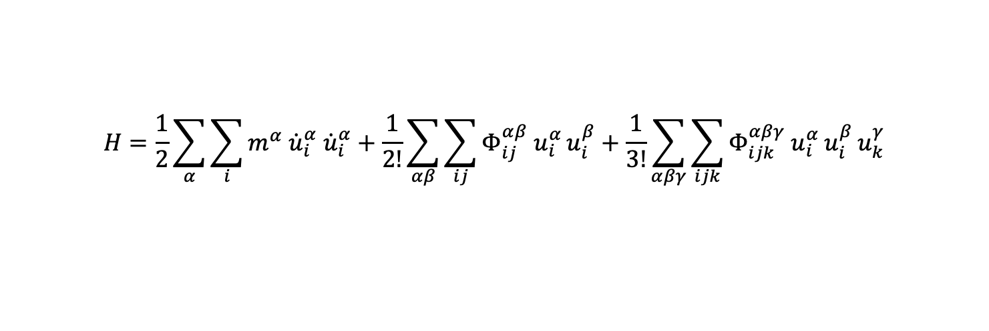
Types of perturbations
Static strain field scattering
$$H=\frac{1}{2}\sum_{α}{\sum_{i}{m^{α}{ \dot{u}}_{i}^{α}{ \dot{u}}_{i}^{α}}}+\frac{1}{2!}\sum_{αβ}{\sum_{ij}{Φ_{ij}^{αβ} u_{i}^{α }u_{i}^{β}}}+\frac{1}{3!}\sum_{αβγ}{\sum_{ijk}{Φ_{ijk}^{αβγ} u_{i}^{α }u_{i}^{β}}}u_{k}^{γ}$$

Slide 10
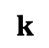
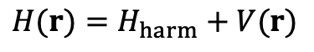
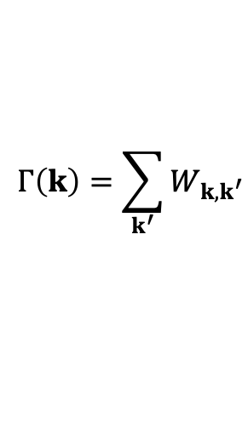
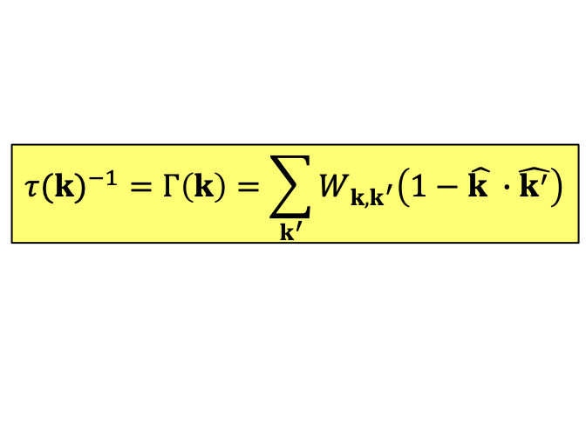
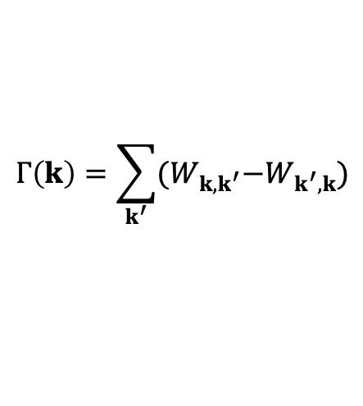
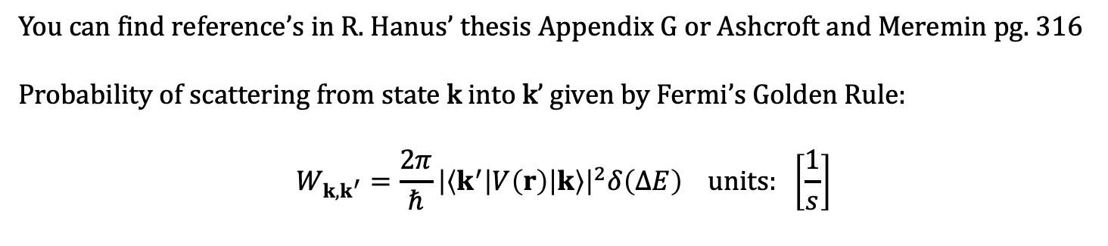
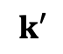
on board
Scattering potential → relaxation time
$$H(r)=H_{harm}+V(r)$$
You can find reference’s in R. Hanus’ thesis Appendix G or Ashcroft and Meremin pg. 316
Probability of scattering from state k into k’ given by Fermi’s Golden Rule:
$$W_{k,k^{′}}=\frac{2π}{ℏ}{\left|\left\langle k^{′}\left|V\left(r\right)\right|k\right\rangle \right|}^{2}δ\left(ΔE\right) units: \left[\frac{1}{s}\right]$$
I$nverse lifetime (Γ(k)$) is the sum over all possible k’ states.
inverse lifetime:
$$Γ\left(k\right)=\sum_{k^{′}}{W_{k,k^{′}}}$$
inverse relaxation time
or scattering rate:
$$Γ\left(k\right)=\sum_{k^{′}}{{(W}_{k,k^{′}}−W_{k^{′},k})}$$
What if k = k’ ? Does this scattering event impede heat conduction?
isotropic approximation, this becomes
$${τ(k)}^{−1}=Γ\left(k\right)=\sum_{k^{′}}{W_{k,k^{′}}\left(1−\hat{k }∙\hat{k^{′}}\right)}$$
$$k$$
$$k′$$
See detail on Relaxation Time Approximation in supplemental slides

Slide 11
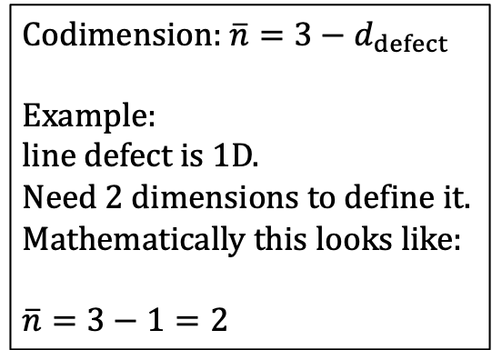
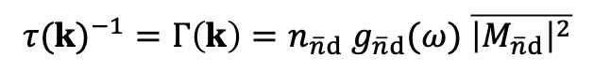
Contributions to the relaxation time
Elastic defect scattering can be expressed as the product of the three factors.
$${τ(k)}^{−1}=Γ\left(k\right)=n_{\overline{n}d} g_{\overline{n}d}(ω) \overline{{\left|M_{\overline{n}d}\right|}^{2}}$$
spatial density of defects
Phase space contribution:
Density of states into which the phonon can scatter.
Matrix element contribution:
Magnitude squared of the Fourier transform of the scattering potential
Codimension: $\overline{n}=3−d_{defect}$
Example:
line defect is 1D.
Need 2 dimensions to define it.
Mathematically this looks like:
$\overline{n}=3−1=2$

Slide 12
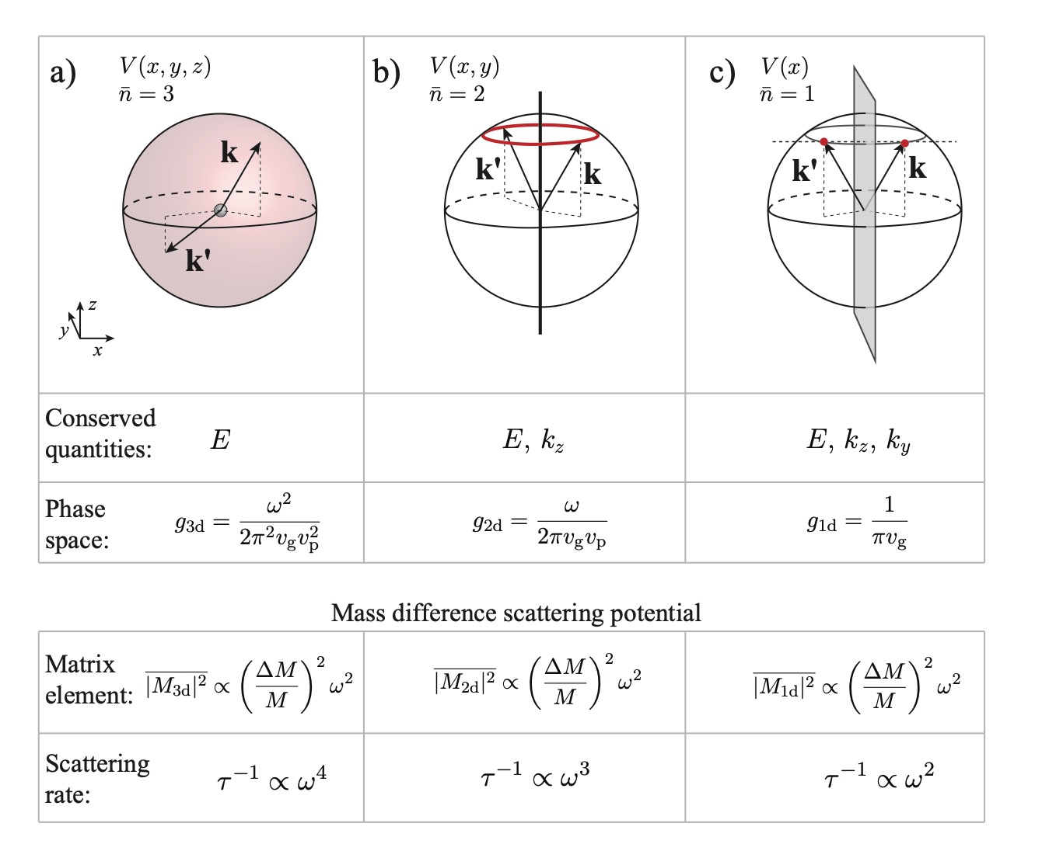
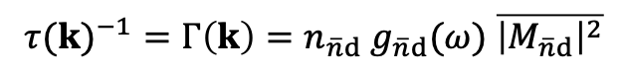
$${τ(k)}^{−1}=Γ\left(k\right)=n_{\overline{n}d} g_{\overline{n}d}(ω) \overline{{\left|M_{\overline{n}d}\right|}^{2}}$$

Slide 13
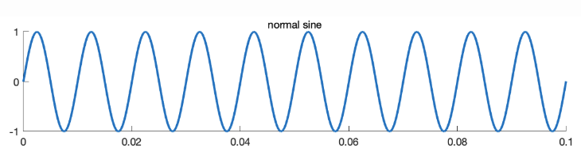
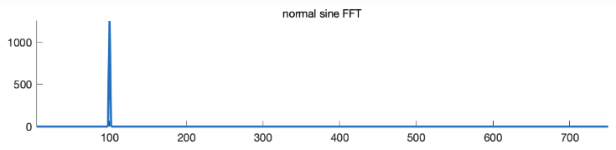
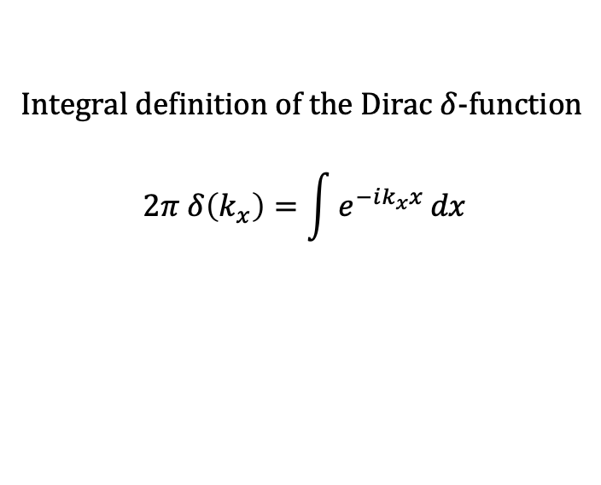
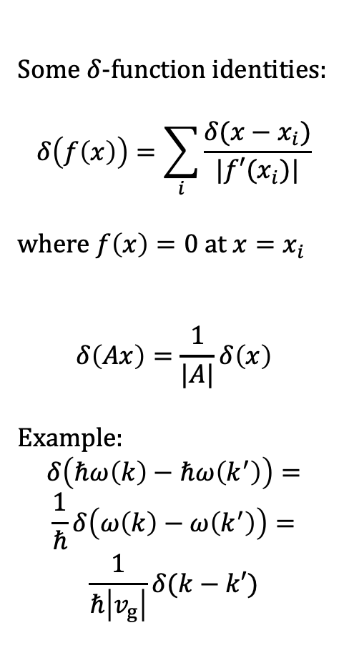
on board
Scattering theory
Required Math
Integral definition of the Dirac $δ$-function
$$2π δ\left(k_{x}\right)=\int{e^{−ik_{x}x}}dx$$
Some $δ$-function identities:
$$δ\left(f\left(x\right)\right)=\sum_{i}{\frac{δ(x−x_{i})}{|f′(x_{i})|}}$$
where $f\left(x\right)=0$ at $x=x_{i}$
$$δ\left(Ax\right)=\frac{1}{|A|}δ\left(x\right)$$
Example:
$$δ\left(ℏω\left(k\right)−ℏω\left(k^{′}\right)\right)=$$
$$\frac{1}{ℏ}δ\left(ω\left(k\right)−ω\left(k^{′}\right)\right)=$$
$$\frac{1}{ℏ\left|v_{g}\right|}δ(k−k′)$$

Slide 14
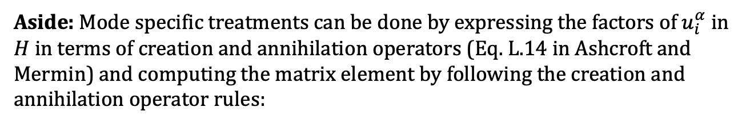
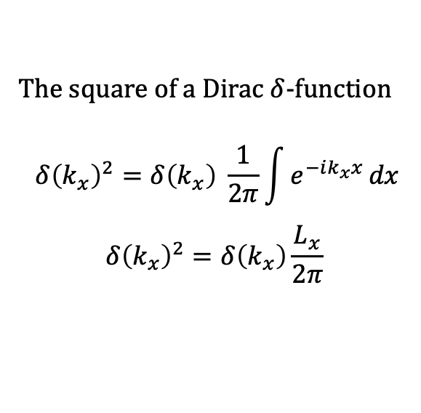
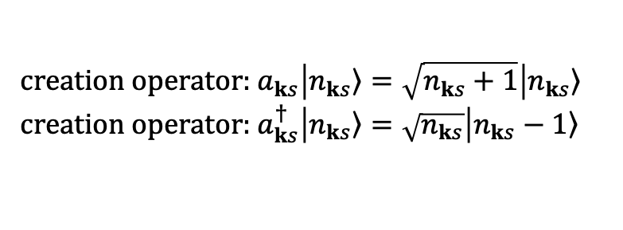
on board
Scattering theory
Required Math
The square of a Dirac $δ$-function
$$δ{\left(k_{x}\right)}^{2}=δ\left(k_{x}\right) \frac{1}{2π}\int{e^{−ik_{x}x}}dx$$
$$δ{\left(k_{x}\right)}^{2}=δ\left(k_{x}\right)\frac{L_{x}}{2π}$$
Note: In the following examples we are building intuition about phase space and matrix element contributions and therefore we apply a ‘spectral’ treatment of scattering theory, making the isotropic single mode approximation.
Aside: Mode specific treatments can be done by expressing the factors of $u_{i}^{α}$ in $H$ in terms of creation and annihilation operators (Eq. L.14 in Ashcroft and Mermin) and computing the matrix element by following the creation and annihilation operator rules:
creation operator: $a_{ks}\left|\left.n_{ks}\right\rangle =\sqrt{n_{ks}+1}\right|\left.n_{ks}\right\rangle$
creation operator: $a_{ks}^{†}\left|\left.n_{ks}\right\rangle =\sqrt{n_{ks}}\right|\left.n_{ks}−1\right\rangle$

Slide 15
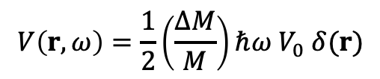
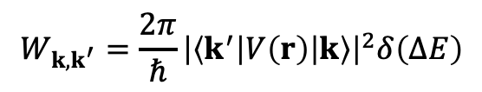
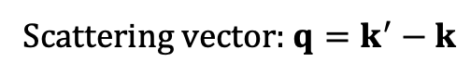
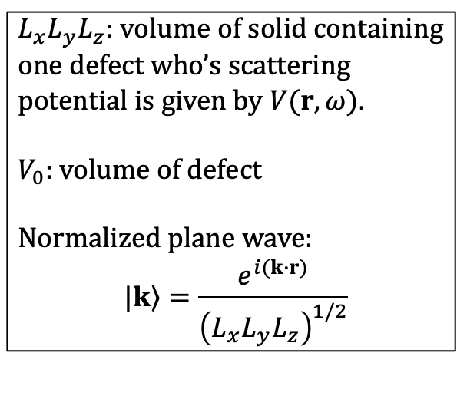
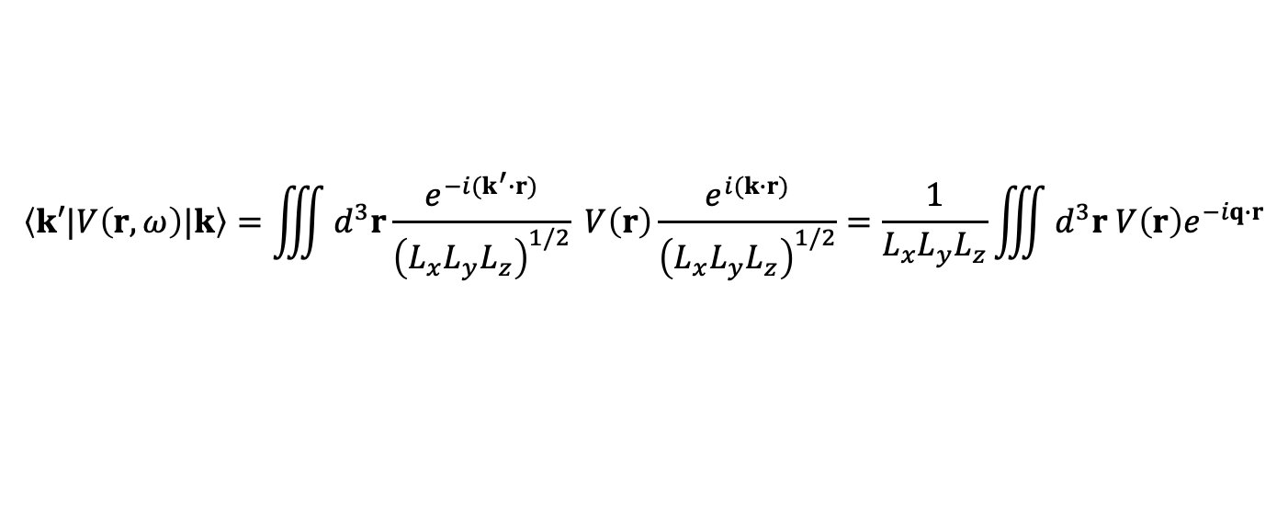
on board
Point defect – Mass contrast
$$V\left(r,ω\right)=\frac{1}{2}\left(\frac{ΔM}{M}\right)ℏω{ V}_{0} δ(r)$$
$$W_{k,k^{′}}=\frac{2π}{ℏ}{\left|\left\langle k^{′}\left|V\left(r\right)\right|k\right\rangle \right|}^{2}δ\left(ΔE\right)$$
$$\left\langle k′|V\left(r,ω\right)|k\right\rangle =\iiint{d^{3}r}\frac{e^{−i{(k}^{′}∙r)}}{{\left(L_{x}L_{y}L_{z}\right)}^{1/2}} V\left(r\right)\frac{e^{i(k∙r)}}{{\left(L_{x}L_{y}L_{z}\right)}^{1/2}}=\frac{1}{L_{x}L_{y}L_{z}}\iiint{d^{3}r V\left(r\right)e^{−iq∙r}}$$
$L_{x}L_{y}L_{z}$: volume of solid containing one defect who’s scattering potential is given by $V(r,ω)$.
$V_{0}$: volume of defect
Normalized plane wave:
$$|\left.k\right\rangle =\frac{e^{i(k∙r)}}{{\left(L_{x}L_{y}L_{z}\right)}^{1/2}}$$
Scattering vector: $q=k^{′}−k$

Slide 16
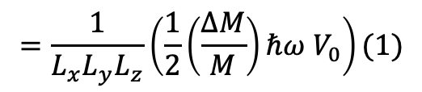
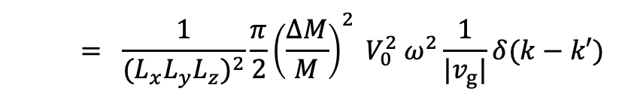
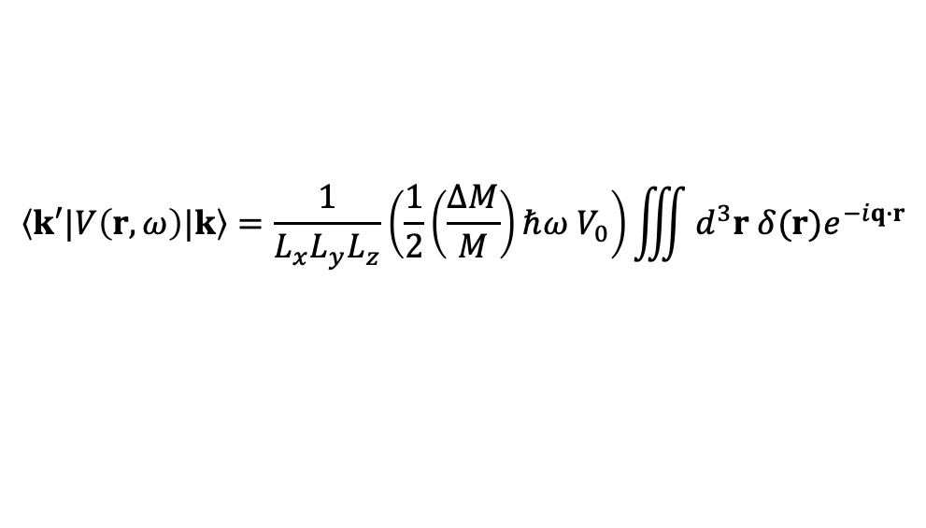



on board
Point defect – Mass contrast
$$\left\langle k′|V\left(r,ω\right)|k\right\rangle =\frac{1}{L_{x}L_{y}L_{z}}\left(\frac{1}{2}\left(\frac{ΔM}{M}\right)ℏω{ V}_{0}\right)\iiint{d^{3}r δ(r)e^{−iq∙r}}$$
$$=\frac{1}{L_{x}L_{y}L_{z}}\left(\frac{1}{2}\left(\frac{ΔM}{M}\right)ℏω{ V}_{0}\right)(1)$$
$${\left|\left\langle k^{′}\left|V\left(r,ω\right)\right|k\right\rangle \right|}^{2}=\frac{1}{{{(L}_{x}L_{y}L_{z})}^{2}}{\left(\frac{1}{2}\left(\frac{ΔM}{M}\right)ℏω{ V}_{0}\right)}^{2}$$
$$δ\left(ΔE\right)=δ\left(ℏω−ℏω^{′}\right)=\frac{1}{ℏ}δ\left(ω−ω^{′}\right)=\frac{1}{ℏ\left|v_{g}\right|}δ(k−k′)$$
$$W_{k,k^{′}}=\frac{2π}{ℏ} \frac{1}{{{(L}_{x}L_{y}L_{z})}^{2}}{\left(\frac{1}{2}\left(\frac{ΔM}{M}\right)ℏω{ V}_{0}\right)}^{2} \frac{1}{ℏ\left|v_{g}\right|}δ(k−k′)$$
$$= \frac{1}{{{(L}_{x}L_{y}L_{z})}^{2}}\frac{π}{2}{\left(\frac{ΔM}{M}\right)}^{2} V_{0}^{2} ω^{2}\frac{1}{|v_{g}|}δ(k−k′)$$

Slide 17












on board
Point defect – Mass contrast
$$k$$
we set k to be in the z-direction so $θ$ (angle between k and k’) equals $θ′$ the polar angle of k’ in spherical coordinates.
$$θ′$$
$$z$$
$$(1−\hat{k }∙\hat{k^{′}})=(1−\cos{θ^{′}})$$
$k$’
$$τ^{−1}=Γ=\sum_{k^{′}}{W_{k,k^{′}}\left(1−\cos{θ′}\right)}=\frac{L_{x}L_{y}L_{z}}{{\left(2π\right)}^{3}}\iiint{W_{k,k^{′}}\left(1−\cos{θ′}\right) d^{3}k′}$$
$$Γ=\frac{L_{x}L_{y}L_{z}}{{{(L}_{x}L_{y}L_{z})}^{2}}\frac{1}{16π^{2}}{\left(\frac{ΔM}{M}\right)}^{2} V_{0}^{2} \iiint{ω^{2}\frac{1}{\left|v_{g}\right|}δ\left(k−k^{′}\right)\left(1−\cos{θ′}\right) d^{3}k^{′}}$$
$$Γ=\frac{n_{3d}}{16π^{2}}{\left(\frac{ΔM}{M}\right)}^{2} V_{0}^{2}\iiint_{0 0 0 }^{∞ 2π π}{ω^{2}\frac{1}{\left|v_{g}\right|}δ\left(k−k^{′}\right)\left(1−\cos{θ′}\right) k^{′2}\sin{θ′} dθ^{′}dφ^{′}dk′}$$
$$\iint_{0 0 }^{2π π}{\sin{θ′} \left(1−\cos{θ^{′}}\right) dθ^{′}dφ′}=4π$$
$$ω=v_{p}k$$
$$Γ=\frac{n_{3d}}{4π}{\left(\frac{ΔM}{M}\right)}^{2} V_{0}^{2}\int_{0}^{∞}{k^{2}v_{p}^{2}\frac{1}{\left|v_{g}\right|}δ\left(k−k^{′}\right) k^{′2} dk′}=\frac{n_{3d}}{4π}{\left(\frac{ΔM}{M}\right)}^{2} V_{0}^{2}\frac{k^{4}v_{p}^{2}}{|v_{g}|}$$

Slide 18




Point defect – Mass contrast
$$Γ=n_{3d}×\left(\frac{ω^{2}}{2π^{2} v_{p}^{2}\left|v_{g}\right|}\right) ×\left(\frac{π}{2} {\left(\frac{ΔM}{M}\right)}^{2} V_{0}^{2}ω^{2}\right)$$
$$Γ=n_{3d}×g_{3d}×\overline{{\left|M_{3d}\right|}^{2}}$$
$$τ{\left(ω\right)}^{−1}=Γ=\frac{n_{3d}V_{0}^{2}}{4π|v_{g}|v_{p}^{2}}{\left(\frac{ΔM}{M}\right)}^{2}ω^{4}$$
A localized scattering potential ($δ(r)$ in $V$) results in $\overline{{\left|M_{3d}\right|}^{2}}∝ω^{2}$. The fact that it’s a point defect (0d, $\overline{n}=3$), means the phonon can scattering into the 3D density of states, $g_{3d}∝ω^{2}$. Together we get the Raleigh scattering, $ω^{4}$ power law.

Slide 19






Line defect – Mass contrast
details in supplemental slides
$$V\left(x,y,ω\right)=\frac{1}{2}\left(\frac{ΔM}{M}\right)ℏω{ A}_{0} δ\left(x\right)δ(y)$$
$$θ$$
$$τ{\left(k\right)}^{−1}=n_{2d}×\frac{ω}{2π v_{p}\left|v_{g}\right|}×\frac{π}{2}{\left(\frac{ΔM}{M}\right)}^{2}A_{0}^{2} ω^{2}\sin{{\left(θ\right)}^{2}}$$
$$τ{\left(k\right)}^{−1}=n_{2d}×g_{2d}×\overline{{\left|M_{2d}\right|}^{2}}$$
$$τ^{−1}=Γ=\frac{n_{2d}A_{0}^{2}}{4 v_{p}|v_{g}|}{\left(\frac{ΔM}{M}\right)}^{2}ω^{3}\sin{{\left(θ\right)}^{2}}$$
A localized scattering potential ($δ\left(x\right)δ(y)$ in $V$) results in $\overline{{\left|M_{3d}\right|}^{2}}∝ω^{2}$. The fact that it’s a line defect (1d, $\overline{n}=2$), means the phonon can scattering into the 2D density of states, $g_{2d}∝ω$. Together we get the $ω^{3}$ power law.

Slide 20





















Elastic defect scattering cheat sheet
$${τ(k)}^{−1}=Γ\left(k\right)=n_{\overline{n}d} g_{\overline{n}d}(ω) \overline{{\left|M_{\overline{n}d}\right|}^{2}}$$
0D (point defect, $\overline{n}=3$)
1D (line defect, $\overline{n}=2$)
2D (planar defect, $\overline{n}=1$)
$$g_{3d}=\frac{ω^{2}}{2π^{2}v_{g}v_{p}^{2}}$$
$$g_{2d}=\frac{ω}{2πv_{g}v_{p}}$$
$$g_{1d}=\frac{1}{πv_{g}}$$
$$M_{3d}(q)=\iiint{V\left(r\right)e^{−iq∙r}dr}$$
$$M_{2d}(q_{x},q_{y})=\iint{V\left(x,y\right)e^{−i(q_{x}x+q_{y}y)}}dxdy$$
$$M_{1d}(q_{x})=\int{V\left(x\right)e^{−i(q_{x}x)}}dx$$
$$\overline{{\left|M_{3d}\right|}^{2}}=\frac{1}{2ℏ^{2}}\int{{\left|M_{3d}\right|}^{2}(1−\hat{k }∙\hat{k′})} dΩ′$$
$$\overline{{\left|M_{2d}\right|}^{2}}=\frac{1}{ℏ^{2}}\int_{0}^{2π}{{\left|M_{2d}\right|}^{2}(1−\hat{k }∙\hat{k′})} dφ′$$
$$\overline{{\left|M_{1d}\right|}^{2}}=\frac{π}{ℏ^{2}} {\left[{\left|M_{2d}\right|}^{2}\left(1−\hat{k }∙\hat{k^{′}}\right)\right]}_{q_{x}=−2k_{x}}$$
$$dΩ^{′}=\sin{θ′}dθ^{′}dφ′$$
$$q_{x}=k\sin{θ(\cos{φ^{′}}−\cos{φ})}$$
$$q=k^{′}−k$$
$$q_{y}=k\sin{θ(\sin{φ^{′}}−\sin{φ})}$$
$$k=k(\sin{θ}\cos{φ},\sin{θ}\sin{φ},\cos{θ})$$
$$\left(1−\hat{k }∙\hat{k^{′}}\right)=2\sin{{\left(θ\right)}^{2}\sin{{\left(\frac{φ^{′}−φ}{2}\right)}^{2}}}$$
$$\left(1−\hat{k }∙\hat{k^{′}}\right)=\frac{2k_{x}^{2}}{k^{2}}$$
$$k′=k(\sin{θ′}\cos{φ′},\sin{θ′}\sin{φ′},\cos{θ′})$$

Slide 21











Phonon-phonon scattering
$b$: any reciprocal lattice vector
Type I:
one phonon decomposes into two
$$k_{3}$$
$$k_{1}=k_{2}+k_{3}+b$$
$${ℏω}_{1}=ℏω_{2}+{ℏω}_{3}$$
$$k_{1}$$
$$k_{2}$$
Type II:
two phonons combine into one
$$k_{3}$$
$$k_{1}+k_{2(3)}=k_{3(2)}+b$$
$${ℏω}_{1}+{ℏω}_{2(3)}={ℏω}_{3(2)}$$
$$k_{1}$$
$$k_{2}$$
Normal scattering process: $b=0$
Umklapp (“flip over”) scattering process: $b≠0$
Maznev, A. A. & Wright, O. B. Demystifying umklapp vs normal scattering in lattice thermal conductivity. Am. J. Phys. 82, 1062–1066 (2014).
Perturbation is $U_{3rd}$
$|\left.i\right\rangle$ and $|\left.f\right\rangle$ are initial and final states (combinations of k₁ k₂ and k₃)
$$W_{i,f}=\frac{2π}{ℏ}{\left|\left\langle f\left|U_{3rd}\right|i\right\rangle \right|}^{2}δ\left(ΔE\right)$$

Slide 22





Phonon-phonon scattering
Phonon-phonon scattering has phase space and matrix element contributions as well.
$$Γ_{pp}\left(ks\right)≈\frac{18π}{ℏ^{2}} N\left(ks\right) P(ks)$$
$N(ks)$ contains the number of other phonons in the material
$N(ks)∝T$ at high temperature
Stems from high-T behavior of Bose-Einstein distribution
weighted joint density of states
average anharmonic interaction phonon $ks$ has with all other phonons
$$n_{BE}=\frac{1}{e^{\frac{ℏω}{k_{B}T}}−1 }≈\frac{1}{1+\frac{ℏω}{k_{B}T}−1}=\frac{k_{B}T}{ℏω}$$
$Γ_{pp}=τ_{pp}^{−1}∝T$ at high temperatures
Togo, A., Chaput, L. & Tanaka, I. Distributions of phonon lifetimes in Brillouin zones. Phys. Rev. B 91, 094306 (2015).

Slide 23


Phonon-phonon scattering
Common analytical form:
$$τ_{pp}^{−1}=C_{1}ω^{2}T\exp{(−C_{2}/T)}$$
Low-$ω$ behavior from DFT based lattice dynamics and phonon-phonon relaxation time.
lines show
$$τ=Aω^{−n}$$
with $n=2$
Si
300K
GaN
300K

Slide 24


Phonon-phonon scattering
Analytical high-T phonon-phonon scattering model
$$τ_{pp}^{−1}={\left(\frac{V}{6π^{2}}\right)}^{\frac{1}{3}}\frac{{2 k}_{B} γ^{2}ω^{2}T}{M v_{g}v_{p}^{2}}$$
Fully analytical thermal conductivity model using the above phonon-phonon scattering expression shows reasonable agreement with experiment across two orders of magnitude.
Good for broad screening across material systems.
Toberer, E. S., Zevalkink, A. & Snyder, G. J. Phonon engineering through crystal chemistry. J. Mater. Chem. 21, 15843 (2011).

Slide 25








Low frequency behavior of spectral thermal conductivity
$$κ=\int_{0}^{ω_{max}}{κ\left(ω\right) dω}$$
$$κ\left(ω\right)=\frac{1}{3}C\left(ω\right)v_{g}{\left(ω\right)}^{2}τ(ω)$$
$$C\left(ω\right)=\frac{k_{B}ω^{2}}{2π^{2}v_{S}^{3}}$$
$$τ(ω)=\frac{A(T)}{ ω^{2}}$$
as $ω→0$
$$v_{g}{\left(ω\right)}^{2}=v_{S}^{2}$$
$$\lim_{ω→0}{κ\left(ω\right)}=\frac{k_{B} A(T)}{6π^{2}v_{S}}$$
$$≠0$$

Slide 26
BZ integration and k-meshing
Si at 300K
12x12x12

Slide 27
BZ integration and k-meshing
Si at 300K
16x16x16

Slide 28
BZ integration and k-meshing
Si at 300K
20x20x20

Slide 29
BZ integration and k-meshing
Si at 300K
30x30x30

Slide 30
















Example Callaway model
Low-T gives information about grain boundary scattering
High-T, $κ∝T^{−1}$ behavior stems from phonon-phonon scattering
T ⁻¹
T ³
Notes:
Check units!!

Slide 31








supplemental
Relaxation time approximation
$$flux=energy density × velocity × number=\frac{Energy}{Area × time}$$
Phonon-gas model for heat flux:
$$j^{i}=\frac{1}{V}\sum_{ks}{ℏω(ks)} v_{g}^{i}(ks) n(ks)$$
$$n\left(ks\right)=n_{BE}\left(ks\right)+n′(ks)$$
$$j^{i}=\frac{1}{V}\sum_{ks}{ℏω(ks)} v_{g}^{i} \left(ks\right)n_{BE}\left(ks\right)+\frac{1}{V}\sum_{ks}{ℏω\left(ks\right)} v_{g}^{i} \left(ks\right)n′\left(ks\right)$$
$$=0$$
$$j^{i}=\frac{1}{V}\sum_{ks}{ℏω(ks)} v_{g}^{i}(ks) n′\left(ks\right)$$
$$j^{i}=−κ^{ij}∇^{j}T$$
compare to solve for $κ^{ij}$
need $n′(ks)$, get it from BTE

Slide 32








supplemental
Relaxation time approximation
suppress $k, s, r, and t$
$$n=n(ks,r,t)$$
$$n_{BE}=n_{BE}(ks,r)$$
$$n^{′}=n′(ks,t)$$
Boltzmann transport equation (BTE)
$$v_{g}^{i} ∇^{i}n+\frac{F^{i}}{ℏ} \frac{d n}{dk^{i}}={\left.\frac{dn}{dt}\right|}_{coll}$$
no external forces on phonons
$$=0$$
$$v_{g}^{i} ∇^{i}n={\left.\frac{dn}{dt}\right|}_{coll}$$
Left side:
Only spatial ($∇^{i} is$real space gradient) dependence of
$n(ks)$ is through spatial dependence of T
$$v_{g}^{i} ∇^{i}n=v_{g}^{i} ∇^{i}(n_{BE}+n^{′})=v_{g}^{i}\left(\frac{dn_{BE}}{dT}∇^{i}T\right)$$
Right side:
Time dependence only through $n′$
Making the Relaxation Time Approx.
$$n^{′}∝e^{−t/τ}$$
$${\left.\frac{dn}{dt}\right|}_{coll}=\frac{d}{dt}\left(n_{BE}+n^{′}\right)=\frac{dn′}{dt}=−\frac{n′}{τ}$$
$$v_{g}^{i}\frac{dn_{BE}}{dT}∇^{i}T=−\frac{n′}{τ}$$
$$n^{′}=−τ v_{g}^{i}\frac{dn_{BE}}{dT}∇^{i}T$$

Slide 33








supplemental
Relaxation time approximation
$$j^{i}=\frac{1}{V}\sum_{ks}{ℏω(ks)} v_{g}^{i}(ks) n′\left(ks\right)$$
$$n^{′}=−τ v_{g}^{j}\frac{dn_{BE}}{dT}∇^{j}T$$
$$j^{i}=−\frac{1}{V}\sum_{ks}{ℏω} v_{g}^{i} τ v_{g}^{j}\frac{dn_{BE}}{dT}∇^{j}T$$
$$j^{i}=−κ^{ij}∇^{j}T$$
$$κ^{ij}=\frac{1}{V}\sum_{ks}{ℏω} v_{g}^{i} τ v_{g}^{j}\frac{dn_{BE}}{dT}$$
$$C=\frac{1}{V}\frac{d(ℏω n_{BE}) }{dT}$$
$$κ^{ij}=\sum_{ks}{C}v_{g}^{i}v_{g}^{j}τ$$
$$κ^{ij}=\sum_{ks}{C}(ks)v_{g}^{i}(ks)v_{g}^{j}(ks)τ(ks)$$

Slide 34









supplemental
Relaxation time and dispersion relation line width
Vibrational amplitude as a function of time:
$$A\left(t\right)=e^{i(ω_{0}+iα)t}=e^{−tα}e^{iω_{0}t}$$
$$α=\frac{1}{τ}$$
Note: $τ$ has same units as $1/ω$
$$t>0$$
$$\tilde{A}\left(t\right)=\int_{0}^{∞}{e^{i(ω_{0}+iα)t}e^{−iωt}dt=\frac{1}{α+i(ω−ω_{0})}}$$
Real part and magnitude squared (${\left|\tilde{A}\left(t\right)\right|}^{2}$) of Fourier transform are a Lorentzian function with FWHM = $2α$
long $τ$
short $τ$

Slide 35







supplemental
Line defect – Mass contrast
$$V\left(x,y,ω\right)=\frac{1}{2}\left(\frac{ΔM}{M}\right)ℏω{ A}_{0} δ\left(x\right)δ(y)$$
$A_{0}$: cross-sectional area of line defect
$$\left\langle k′|V\left(r,ω\right)|k\right\rangle =\frac{1}{L_{x}L_{y}L_{z}}\left(\frac{1}{2}\left(\frac{ΔM}{M}\right)ℏω{ A}_{0}\right)\iiint{ δ\left(x\right)δ\left(y\right) e^{−i(q_{x}x+q_{y}y+q_{z}z)} dx dy dz}$$
$$\left\langle k′|V\left(r,ω\right)|k\right\rangle =\frac{1}{L_{x}L_{y}L_{z}}\left(\frac{1}{2}\left(\frac{ΔM}{M}\right)ℏω{ A}_{0}\right)\left(1\right)\left(1\right)\int{e^{−iq_{z}z} dz}$$
$$\left\langle k′|V\left(r,ω\right)|k\right\rangle =\frac{1}{L_{x}L_{y}L_{z}}\left(\frac{1}{2}\left(\frac{ΔM}{M}\right)ℏω{ A}_{0}\right)2π δ(q_{z})$$
$${\left|\left\langle k^{′}\left|V\left(r,ω\right)\right|k\right\rangle \right|}^{2}=\frac{1}{{\left(L_{x}L_{y}L_{z}\right)}^{2}}\frac{1}{4}{\left(\frac{ΔM}{M}\right)}^{2}{\left(ℏω\right)}^{2}{ A}_{0}^{2} {\left(2π\right)}^{2}δ{\left(q_{z}\right)}^{2}$$
$$=\frac{1}{{\left(L_{x}L_{y}L_{z}\right)}^{2}}\frac{1}{4}{\left(\frac{ΔM}{M}\right)}^{2}{\left(ℏω\right)}^{2}{ A}_{0}^{2} 2π δ\left(q_{z}\right)L_{z}$$

Slide 36






supplemental
Line defect – Mass contrast
$$W_{k,k^{′}}=\frac{2π}{ℏ} \frac{1}{{{(L}_{x}L_{y})}^{2}L_{z}}\frac{1}{4}{\left(\frac{ΔM}{M}\right)}^{2}{\left(ℏω\right)}^{2}{ A}_{0}^{2} 2π δ\left(k_{z}−k_{z}^{′}\right)\frac{1}{ℏ\left|v_{g}\right|}δ(k−k′)$$
$$Γ=\frac{L_{x}L_{y}L_{z}}{{\left(2π\right)}^{3}}\iiint{W_{k,k^{′}}\left(1−\hat{k }∙\hat{k^{′}}\right) d^{3}k′}$$
$$Γ=\frac{π^{2}}{8π^{3}}\frac{L_{x}L_{y}L_{z}}{{{(L}_{x}L_{y})}^{2}L_{z}}{\left(\frac{ΔM}{M}\right)}^{2}{ A}_{0}^{2}\iiint{ ω^{2} δ\left(k_{z}−k_{z}^{′}\right)\frac{1}{\left|v_{g}\right|}δ(k−k′) \left(1−\hat{k }∙\hat{k^{′}}\right) d^{3}k′}$$
$$Γ=\frac{n_{2d}}{8π}{\left(\frac{ΔM}{M}\right)}^{2}{ A}_{0}^{2} \iiint_{0 0 0}^{∞ 2π π}{k^{2}v_{p}^{2} δ\left(k_{z}−k_{z}^{′}\right)\frac{1}{\left|v_{g}\right|}δ\left(k−k^{′}\right) \left(1−\hat{k }∙\hat{k^{′}}\right) k^{′2}\sin{θ′}dθ^{′}dφ^{′}dk′}$$
$$δ\left(k_{z}−k_{z}^{′}\right)=δ\left(k\cos{θ}−k^{′}\cos{θ′}\right)$$
since this is multiplied by $δ(k−k′)$, we can pull out the $k$
$$δ\left(k\cos{θ}−k^{′}\cos{θ′}\right)=\frac{1}{k}δ\left(\cos{θ}−\cos{θ^{′}}\right)=\frac{1}{k\left|\sin{θ}\right|}δ(θ−θ′)$$

Slide 37







supplemental
Line defect – Mass contrast
$$Γ=\frac{n_{2d}}{8π}{\left(\frac{ΔM}{M}\right)}^{2}{ A}_{0}^{2} \iiint_{0 0 0}^{∞ 2π π}{v_{p}^{2}\frac{k^{2}}{k\left|\sin{θ}\right|}δ(θ−θ′)\frac{1}{\left|v_{g}\right|}δ\left(k−k^{′}\right) \left(1−\hat{k }∙\hat{k^{′}}\right) k^{′2}\sin{θ′}dθ^{′}dφ^{′}dk′}$$
Can take the integrals over $k′$ and $θ′$
$$Γ=\frac{n_{2d}}{8π}{\left(\frac{ΔM}{M}\right)}^{2}{ A}_{0}^{2}\frac{k^{3}v_{p}^{2}}{\left|v_{g}\right|}\int_{0}^{2π}{\left(1−\hat{k }∙\hat{k^{′}}\right) dφ^{′}}$$
$$\left(1−\hat{k }∙\hat{k^{′}}\right)=2\sin{{\left(θ\right)}^{2}\sin{{\left(\frac{φ−φ^{′}}{2}\right)}^{2}}}$$
with $θ=θ′$
$$\int_{0}^{2π}{2\sin{{\left(θ\right)}^{2}\sin{{\left(\frac{φ−φ^{′}}{2}\right)}^{2}}}dφ^{′}=2π\sin{{\left(θ\right)}^{2}}}$$
$$Γ(k)=\frac{n_{2d}}{4}{\left(\frac{ΔM}{M}\right)}^{2}{ A}_{0}^{2}\frac{k^{3}v_{p}^{2}}{\left|v_{g}\right|}\sin{{\left(θ\right)}^{2}}=\frac{n_{2d}}{4}{\left(\frac{ΔM}{M}\right)}^{2}{ A}_{0}^{2}\frac{ω^{3}}{v_{p}\left|v_{g}\right|}\sin{{\left(θ\right)}^{2}}$$

